Slide 1
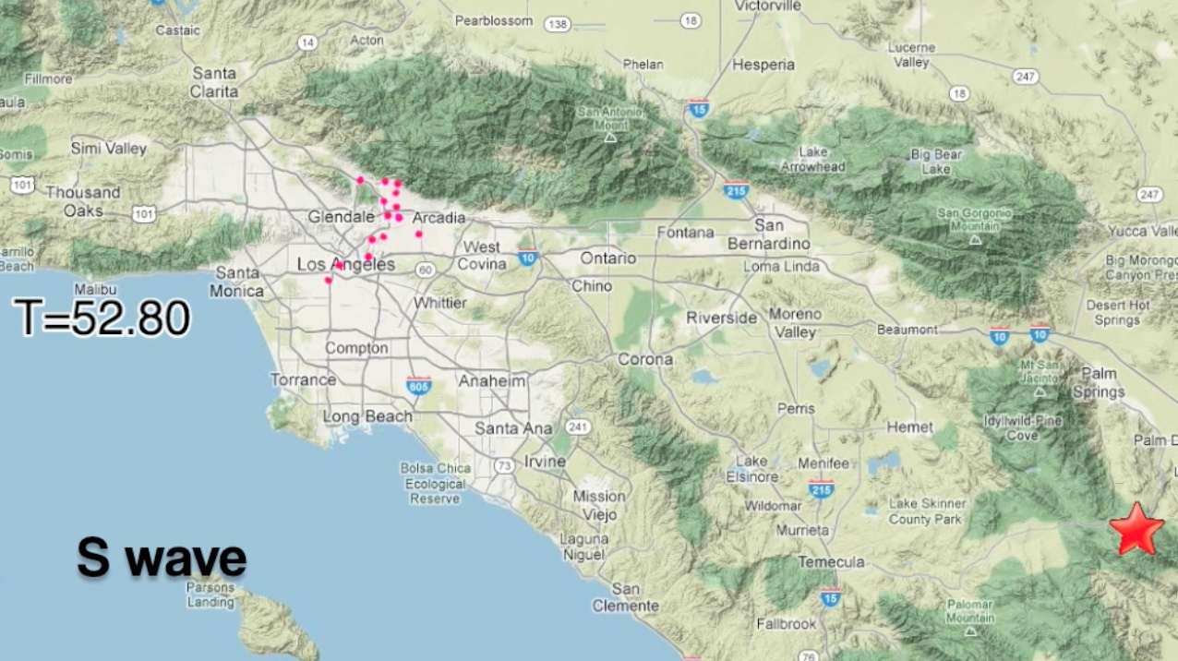

A Fresh Perspective:
Learning to Sparsify for Detection in Massive Noisy Sensor Networks
Matthew Faulkner Annie Liu Andreas Krause
IPSN 4/9/2013

Slide 2
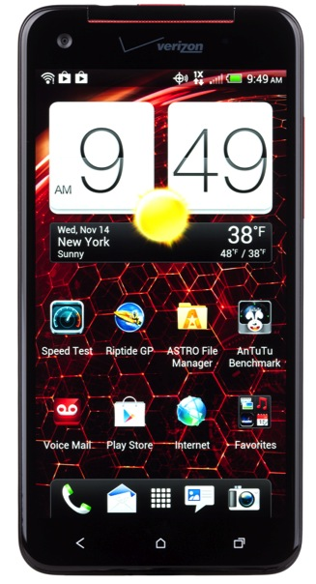
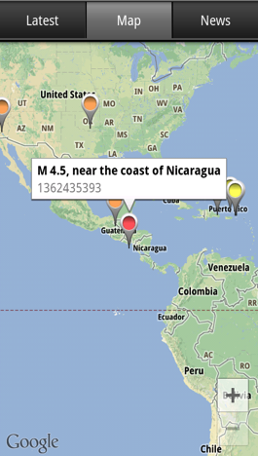
Community Sensors
More than 1 Billion smart devices provide powerful internet-connected sensor packages.
Video
Sound
GPS
Acceleration
Rotation
Temperature
Magnetic Field
Light
Humidity
Proximity

Slide 3
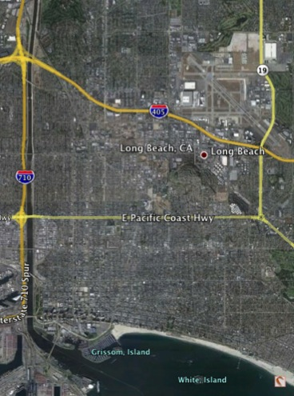
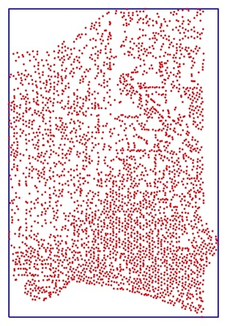

Dense, City-wide Networks
What could dense networks measure?
Signal Hill Seismic Survey
5000 Seismometers

Slide 4
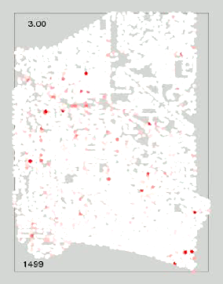
Dense, City-wide Networks
What could dense networks measure?
Signal Hill Seismic Survey
5000 Sesimometers

Slide 5
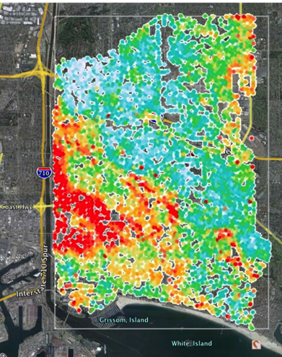
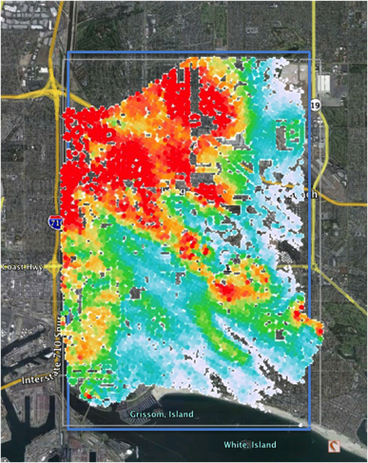
Long Beach Seismic Network

Slide 6
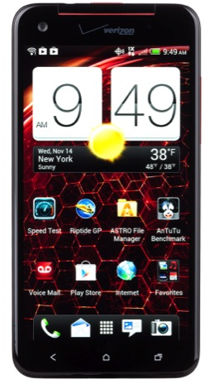

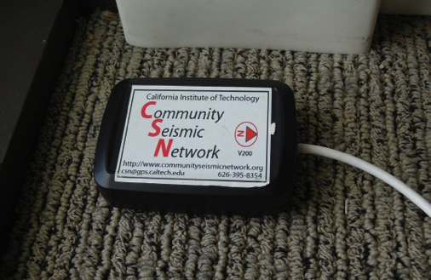
Caltech Community Seismic Network
Detecting and Measuring quakes with community sensors
16-bit USB Accelerometer
CSN-Droid Android App

Slide 7
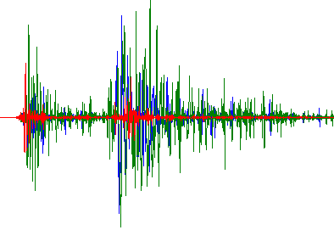



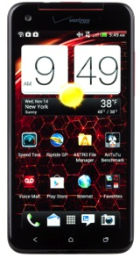
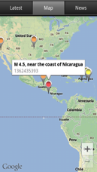
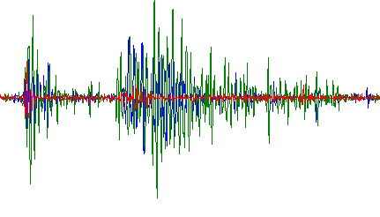


Scaling with Decentralized Detection
Quake?
5000 Long Beach: 250 GB/day
300K LA: 15 TB/day

Slide 8


Scaling with Decentralized Detection
Quake?
Optimal decentralized tests
Hypothesis testing
[Tsitsiklis ‘88]
Local Detection
But strong assumptions…

Slide 9
‘Weak’ Signals in Massive Networks
No pick
Pick

Slide 10
‘Weak’ Signals in Massive Networks
No pick
Pick

Slide 11
‘Weak’ Signals in Massive Networks
No pick
Pick

Slide 12
‘Weak’ Signals in Massive Networks
No pick
Pick

Slide 13



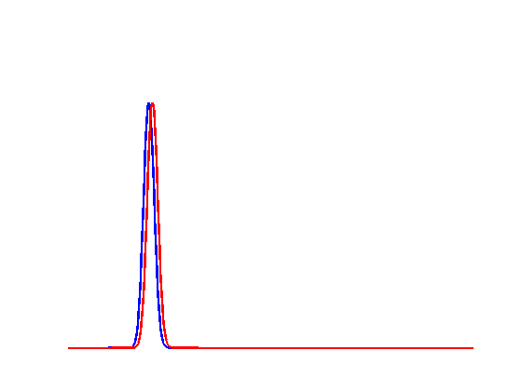
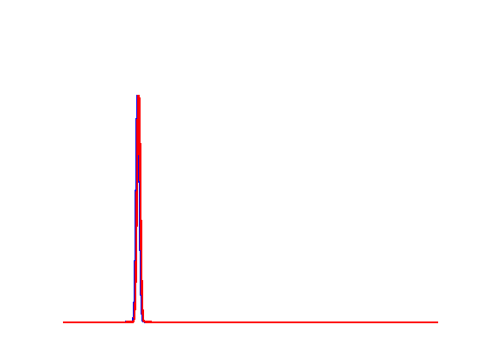
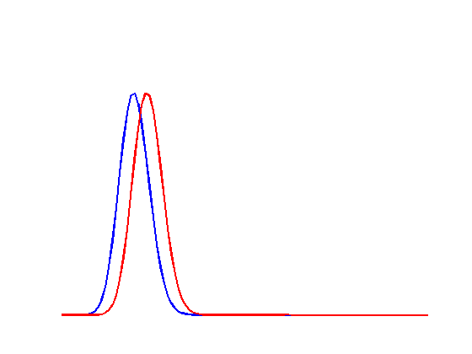
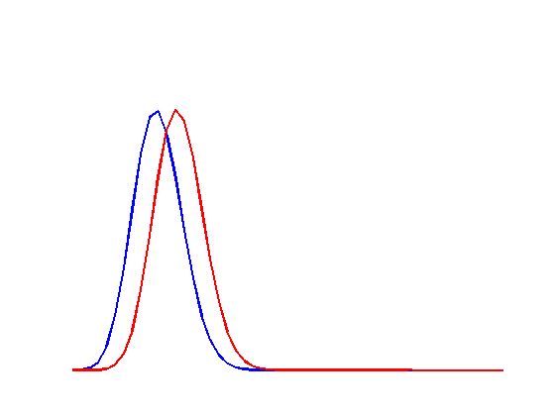
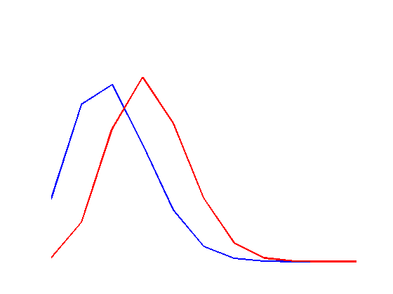










Trading Quantity for Quality?
Detecting arbitrary weak signals requires diminishing noise

Slide 14

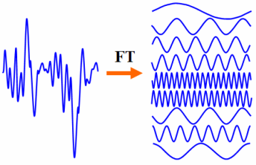



“Sparsifiable” Events

Slide 15




A Basis from Clustering
Hierarchical clustering defines an orthonormal basis
1
0
1
1
-1
0
1
1
0
1
-1
1
0
-1
-1
1
Haar Wavelet Basis
1
0
1
-1
0
1
0
1
-1
0
-1
-1

Slide 16







Latent Tree Model
Hierarchical dependencies can produce sparsifiable signals.

Slide 17
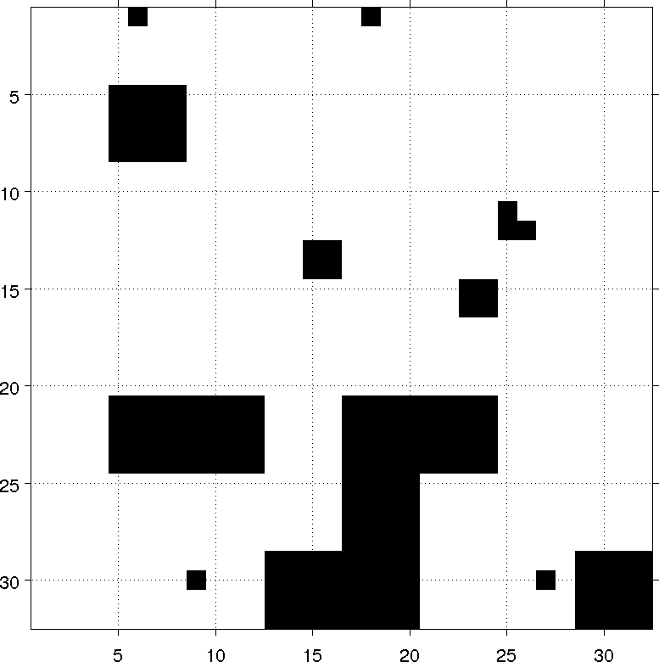
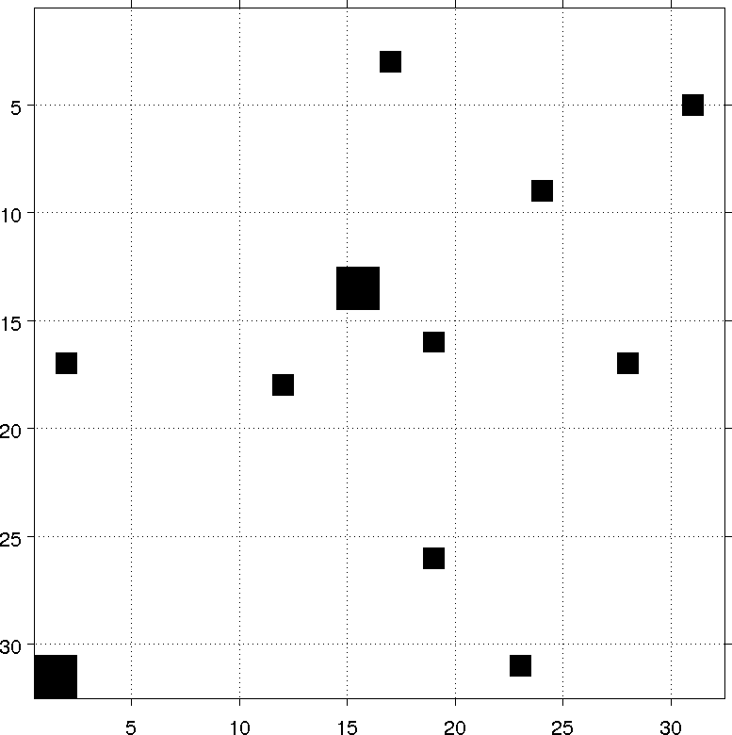



Latent Tree Model
Hierarchical dependencies can produce sparsifiable signals.

Slide 18
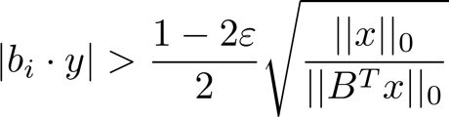








From Sparsification to Detection
Applying the basis to observed data gives a detection rule
Lots of noisy sensors can be reliable!

Slide 19




Learning a Sparsifying Basis
Given real data, can we learn a sparsifying basis?
Continuous, smooth
ICA [Hyvärinen & Oja ‘00]
Efficient, but assumes noise-free observations X

Slide 20
Learning a Sparsifying Basis
Given real data, can we learn a sparsifying basis?
SLSA [Chen 2011]
Learns the basis from noisy data

Slide 21
Synthetic Experiments
Event signals generated from Singh’s Latent Tree Model
Gaussian noise
Binary noise
Noise Variance
Binary Error Rate
Learned bases (ICA, SLSA) outperform baseline average and wavelet basis

Slide 22
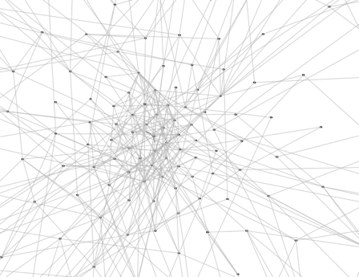
Outbreaks on Gnutella P2P
1769 High-degree nodes in the Gnutella P2P network.
40,000 simulated cascades.
AUC(0.05)
snap.stanford.edu
Binary noise rate
Learned bases (SLSA, ICA) outperform scan statistics

Slide 23
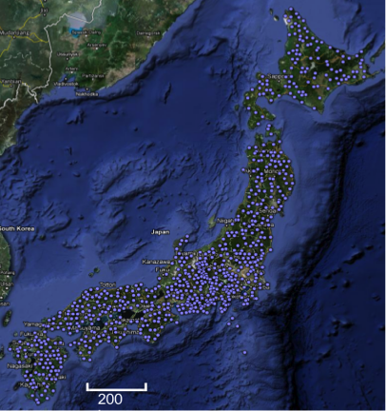
Japan Seismic Network
2000+ quakes recorded after the 2011 Tohoku M9.0 quake
AUC(0.001) – small tolerance to false positive
Binary noise rate
721 Hi-net seismometers

Slide 24
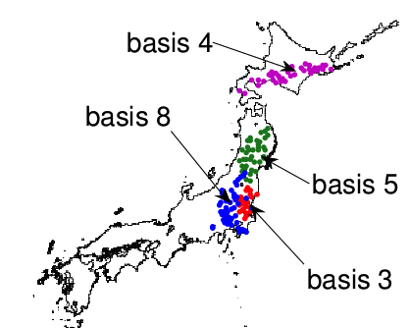
Japan Seismic Network
AUC(0.001) – small tolerance to false positive
Binary noise rate
Learned basis elements capture wave propagation

Slide 25
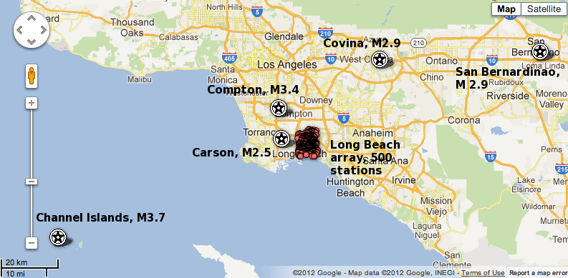
Long Beach Sesimic Network
1,000 sensors
Five M2.5 - M3.4 quakes

Slide 26
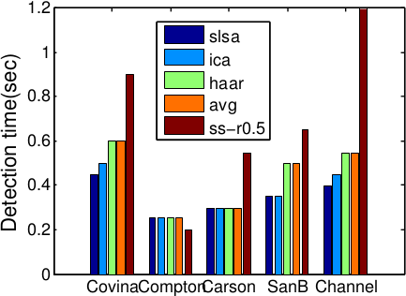
Long Beach Seismic Network
2000 simulated quakes provide training data
Learned bases (SLSA, ICA) outperform wavelet basis and scan statistics

Slide 27
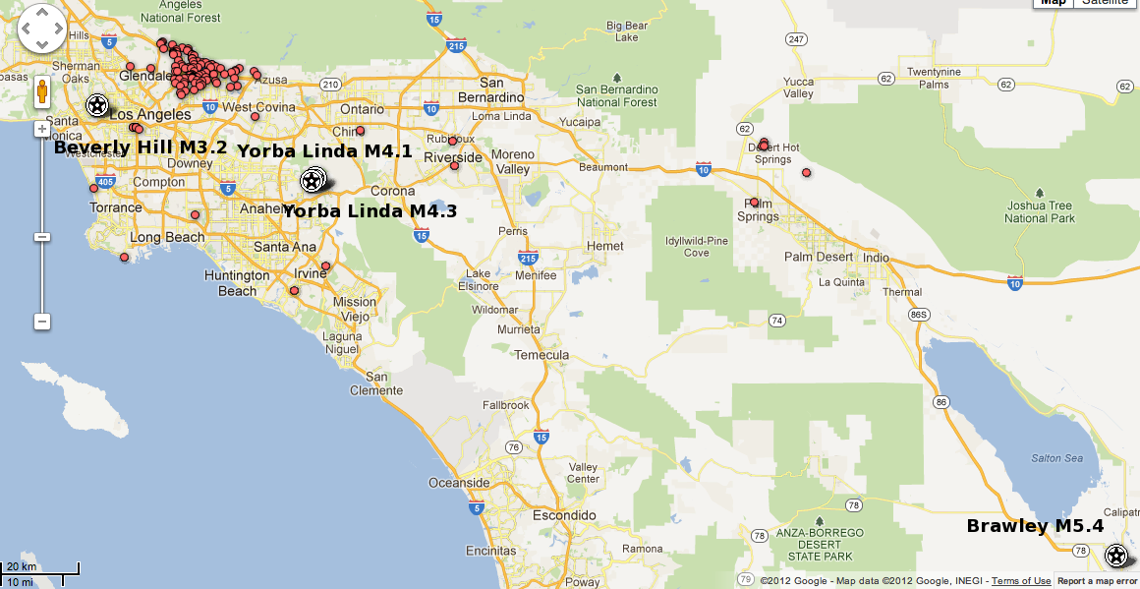
Caltech Community Seismic Network
128 sensors
Four M3.2 – M5.4 quakes

Slide 28
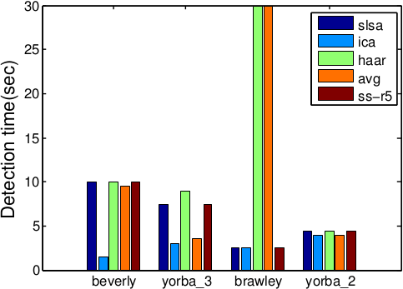
Caltech Community Seismic Network
Trained on 1,000 simulated quakes
Learned bases (SLSA, ICA) detect quakes up to 8 seconds faster

Slide 29
Conclusions
Real-time event detection in massive, noisy community
sensor networks
Theoretical guarantees about decentralized detection of sparsifiable events
Framework for learning sparsifying bases from simulations or sensor measurements
Strong experimental performance on 3 seismic networks, and simulated epidemics in P2P networks

