Slide 1





Dynamic Resource Allocation in Conservation Planning
Daniel Golovin
Andreas Krause
Beth Gardner Sarah Converse Steve Morey
California Institute of Technology
Center for the Mathematics of Information
1
Notes:
AAAI Talk: Thursday, August 2011 at 10:20 am, slot is 20 minutes total.
AAAI presentation/poster [20 min slot]
>> Generate outline on slides.
Outline:
- Throughout: explain how our problem exhibits many characteristics of other problems in computational sustainability.
- Introduce application, including instance specifics ("Reserve network in WA").
- Explain model (patch dynamics, how we get the params, ) including temporal/sequential aspect.
- Formulate optimization problem
- Explain how to treat it as a submodular problem (assumptions we make, things we give up): "We optimize instead this submodular lower bound..."
- Algorithmic details (lightweight)
- Guarantees of the algorithm
- Results
- Extensions
-
Points to highlight: * Reserve design as example of sequential decision making in computational sustainability
* Can extend existing work on submodular optimization to sequential decision making (where info is revealed over time)
* Explain intuition behind which probabilistic models admit this submodular approach (can handle global correlations in weather, etc, only local correlations related to colonization), and why we believe the submodular approximation is a good one in practice. [Note our error is pessimal, since we optimize a lower bound on survival probability].
* Detailed case study (sophisticated, rich, extendible model; spatial aspect; expert workshops, features from actual GIS)
* Relate our problem's characteristics to other problems in computational sustainability (long term planning, planning under uncertainty, partial observability, scaling, sequentiality of the problem)

Slide 2
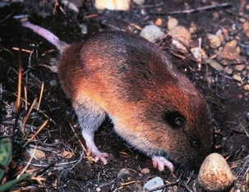
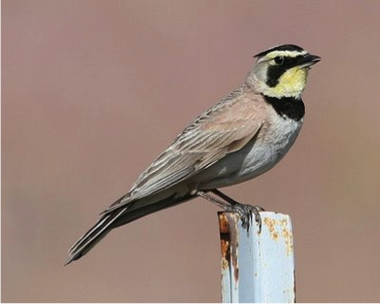
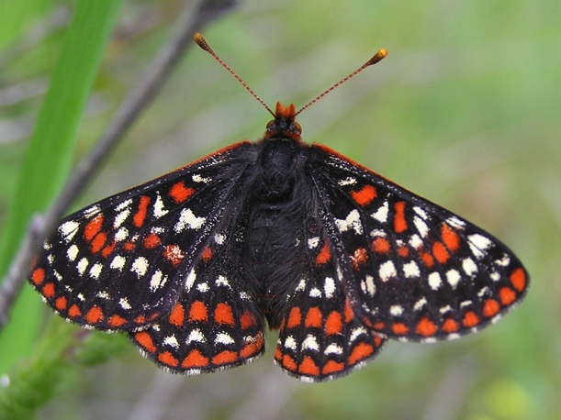
Ecological Reserve Design
How should we select land for conservation
to protect rare & endangered species?
Case Study: Planned Reserve in Washington State
Mazama pocket gopher
streaked horned lark
Taylor’s checkerspot
Notes:
We looked at a really interesting problem in computational sustainbility

Slide 3
Problem Ingredients
Land parcel details
  About 5,300 parcels
  soil types, vegetation, slope
  conservation cost
Notes:
This is a large scale problem, with 5300 parcels, exhibiting wide variation in soil type, …
5274 parcels, to be exact.

Slide 4
Problem Ingredients
Land parcel details
Geography: Roads, Rivers, etc

Slide 5
Problem Ingredients
Land parcel details
Geography: Roads, Rivers, etc
Model of Species’ Population Dynamics
  Reproduction, Colonization, Predation, Disease, Famine, Harsh Weather, …

Slide 6







Population Dynamics
Modeled using a
Dynamic Bayesian
Network
Our Choices
Protected
Parcels
Time t
Environmental
Conditions
(Markovian)
Time t+1
Notes:
Show transition across time (one slide), and draw DBN (see paper, Fig 1c) and use an animation to match problem ingredients to elements of the DBN

Slide 7
Population Dynamics
Modeled using a
Dynamic Bayesian
Network
Our Choices
Protected
Parcels
Time t
Environmental
Conditions
(Markovian)
Time t+1
Notes:
Show transition across time (one slide), and draw DBN (see paper, Fig 1c) and use an animation to match problem ingredients to elements of the DBN
Rearrange animation to put R 2nd to last.

Slide 8
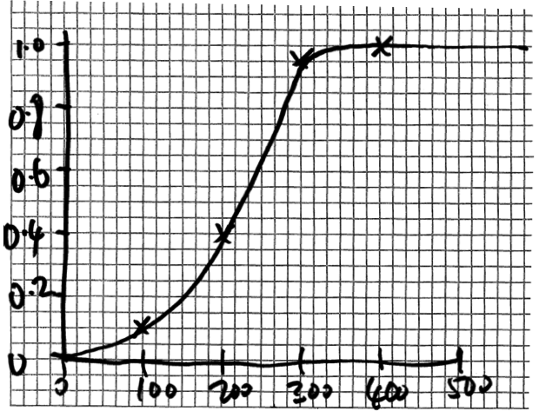
  Model Paramters
From the ecology literature, or
Elicited from panels of domain experts
Annual Patch Survival Probability
Patch Size (Acres)

Slide 9
From Parcels to Patches
Patch 1
Patch 2
Most parcels are too small
to sustain a gopher family
So we group parcels into larger patches.
We assume no colonization between patches,
and model only colonization within patches.
We optimize over (sets of) patches.
Notes:
Explain parcels may be too small to sustain a population long term…
10,000 patches
Give it as a modeling assumption?

Slide 10
The Objective Function
Pr[alive after 50yrs]
0.8
0.7
0.5
Selected patches R
f(R)= 2.0
(Expected # alive)
In practice, use sample
average approximation
Choose R to maximize species persistence
Notes:
Two pictures of distinct reserve designs, one good, one bad, and explain what the objective is.
Discuss our intuition for what makes a good reserve design (e.g., robustness to spatially correlated effects.)

Slide 11


“Static” Conservation Planning
Select a reserve of maximum utility, subject to budget constraint
NP-hard
But f is submodular ➔ We can
find a near-optimal solution

Slide 12
Structure in Reserve Design
A
B
Diminishing returns:
helps more in case A than in case B
Utility function f is submodular:
Notes:
\forall R\subseteq R', p\notin R': f(R\cup \{p\})-f(R)\geq f(R'\cup\{p\})-f(R')

Slide 13
Solving the “Static”
Conservation Planning Problem
Theorem [Sviridenko ‘04]:
We can efficiently obtain reserve R such that
More efficient algorithm with slightly weaker guarantees [Leskovec et al. ‘07]

Slide 14
Selected patches
are very diverse
Notes:
- Spatial spread out to protect against spatially correlated dangers (e.g., weather, disease, etc)
Vary in size.
Some patches are near rivers, some lakes, some far inland.

Slide 15
Results: “Static” Planning
Can get large gain through optimization
Notes:
Lesson from plot?

Slide 16
Dynamic Conservation Planning
Build up reserve over time
At each time step t, the budget B_{t} and the set V_{t} of available parcels may change
Need to dynamically allocate budget to
maximize value of final reserve
Time t
Time t+1
Notes:
The actual real world process is more complex…

Slide 17
Opportunistic Allocation for
Dynamic Conservation
In each time step:
  Available parcels
  and budget appear
  Opportunistically choose
  near-optimal allocation
Time t=2
Time t=1
Theorem: We get at least 38.7% of the value of the best clairvoyant algorithm*
* Even under adversarial selection of available parcels & budgets.
Notes:
Sheldon et al, ’10
(unintentionally) provide support for
Submodularity-based Approaches.
(e-1)/(2e-1) = 0.387…

Slide 18
Results: Dynamic Planning
Large gain from optimization & dynamic selection
Notes:
Discuss faulty selection?

Slide 19
Dynamic Planning w/Failures
Parcel selection may fail
  Purchase recommendations unsuccessful
  Patches may turn out to be uninhabitable
Can adaptively replan, based on observations
Opportunistic allocation still near-optimal
  Proof uses adaptive submodularity [Golovin & Krause ‘10]

Slide 20
Dynamic Planning w/Failures
50% failure rate
Failures increase the benefit of adaptivity

Slide 21
Related Work
Existing software
  Marxan [Ball, Possingham & Watts ‘09]
  Zonation [Moilanen and Kujala ‘08]
  General purpose software
  No population dynamics modeling, no guarantees
Sheldon et al. ‘10
  Models non-submodular population dynamics
  Only considers static problem
  Relies on mixed integer programming
Notes:
Maximizing the Spread of Cascades Using Network Design, Sheldon et al UAI 2010.

Slide 22
Conclusions
Reserve design: prototypical optimization
problem in CompSustAI
  Large scale, partial observability, uncertainty,
  long-term planning, …
Exploit structure ➔ near-optimal solutions
General competitiveness result about opportunistic allocation with submodularity

